Slide 1
Exploring Toronto neighbourhood for opening an Indian Restaurant
By Abhijit Chatterjee
31-Mar-21

Slide 2
Business Problem & Beneficiaries
Problem
In a city like Toronto, it is difficult to identify a suitable location where an entrepreneur can open an Indian Restaurant which will be able to attract and serve authentic traditional Indian food to maximum customer which in turn would help to expand the business and to make it profitable. Our Project is to explore Toronto neighbourhoods and recommend best suitable location to open an Indian Restaurant
Beneficiaries
The Investor/Businessman who wants to invest in the Indian Restaurant start-up and slowly expand their footprint in the segment to make it more profitable.
The professionals in different fields who wants to own an Indian restaurant will be beneficial from this project by understanding different pros and cons, the competition in the field one can expect, analysing the expected customer footfall to generate profitability and to become a successful entrepreneur.
The Indian crowd living in areas who wants to taste the authentic food of India but having limited option will be beneficial from this project.

Slide 3
Data Acquisition and Cleaning
Acquired data from following sources involved:
List of postal code and Neighbourhood in Toronto : https://en.wikipedia.org/wiki/List_of_postal_codes_of_Canada:_M
Geospatial data: https://cocl.us/Geospatial_data
Ethnic Population of Toronto: https://en.m.wikipedia.org/wiki/Demographics_of_Toronto#Ethnic_diversity
Location Data using Foursquare API
Data Cleaning:
Data retrieved from wiki in raw format is cleaned and formatted
Location data and postal code merged
Ethnic population data converted into standard format for Indian Ethnic

Slide 4

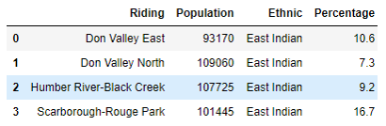

Different Dataset
Location and Postal code:
Ethnic Data
FourSqaure Data

Slide 5
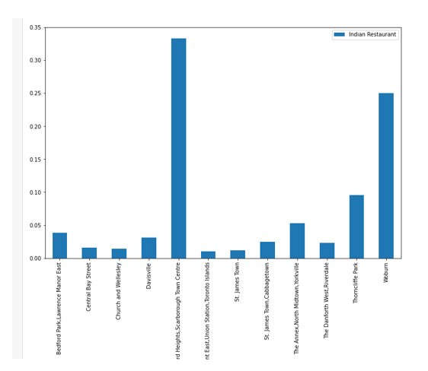
Indian Restaurant Population

Slide 6
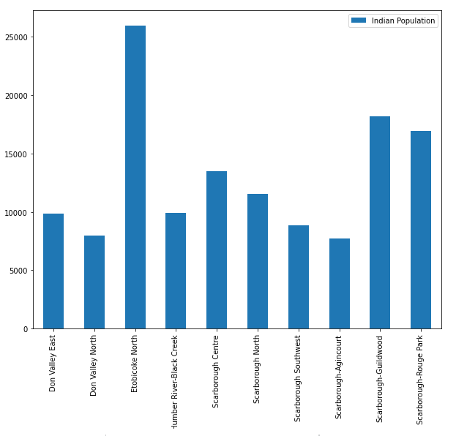
Indian Ethnic Population

Slide 7
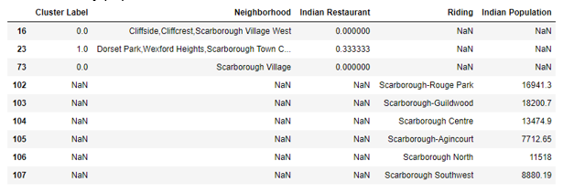
Relationship between Indian Restaurant and Indian Population
No direct relationship establieshed as the Riding and Neighbourhood are not exactly same. However, for Indian population data, by riding names, most of the ridings are it quite identifiable which Borough it belongs to. Indian Restaurant data also populated by neighbourhood/Borough.

Slide 8
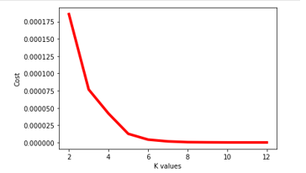
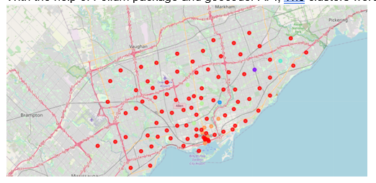
Classification Model
Elbow Method: K=6
Clustering and Plotting:

Slide 9
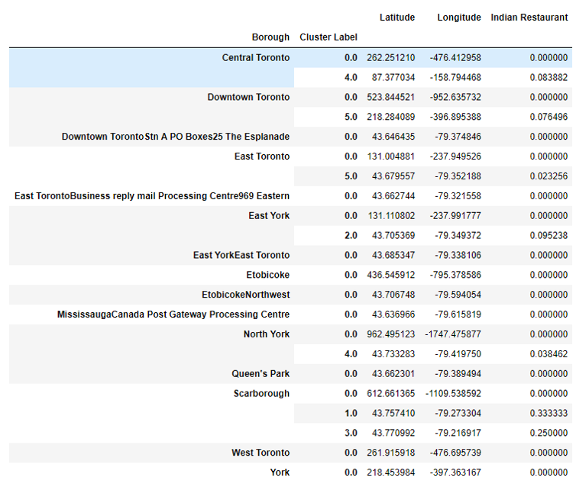
Indian Restaurant Clusters in Toronto by Borough

Slide 10
Discussion and Conclusion
Discussion
The Boroughs like Central Toronto, Downtown Toronto,East Toronto,East York, North York, Scarborough are sparsly or densely populated with Indian Restaurant.
From the Indian population bar chart, it is also clearly visible that scarborogh is also modertely populated with Indians.
So opening a restaurant in Scarborough might attract good foot fall but competetion will be high
Etobicocke is one borough which have most densly indian population.
Also there is no Indian Restaurant in Etobicocke borough
Other boroughs like West Toronto, York, Queen's Park, Etobicoke, Mississauga Canada Post Gateway Processing Centre neither have Indian population, nor have Indian Restaurant
Conclusion:
With Above analysis, it is recommended to leave Scarborough to avoid Higher competition which would impact the lesser profitability. Etobicoke is the Borough which should be considered to open Indian Restaurant due to heavy Indian Population and Limited to no competition.

